Slide 1


FAI PROJECT
PRESENTED BY : GROUP 4
Class & group : 20bd2 group b

Slide 2
What all topics to be covered
PROJECT PROBLEM STATEMENT
KEY FEATURES AND BENEFITS OF OUR PROJECT
LIST OF SOFTWARES TO BE USED
PYTHON MODULES USED
USES OF ALL MODULES
DELEVIRABLES (PROJECT TO BE DELEVIRED)

Slide 3
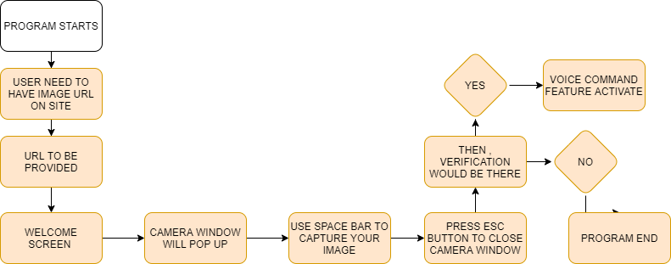

PROJECT PROBLEM STATEMENT

Slide 4
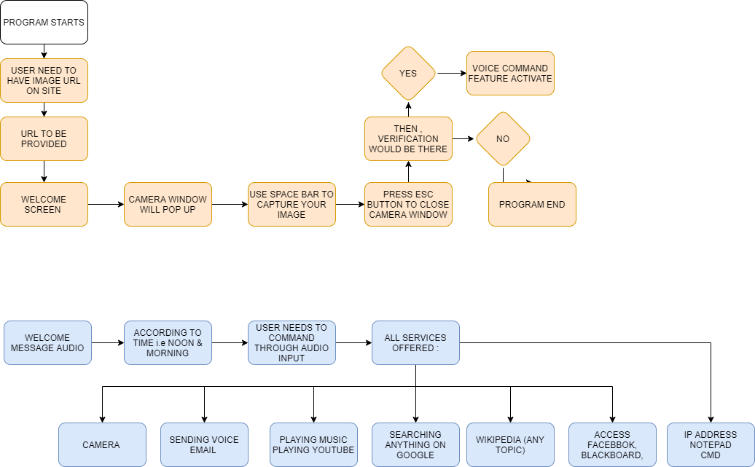
Features included in Voice Command

Slide 5
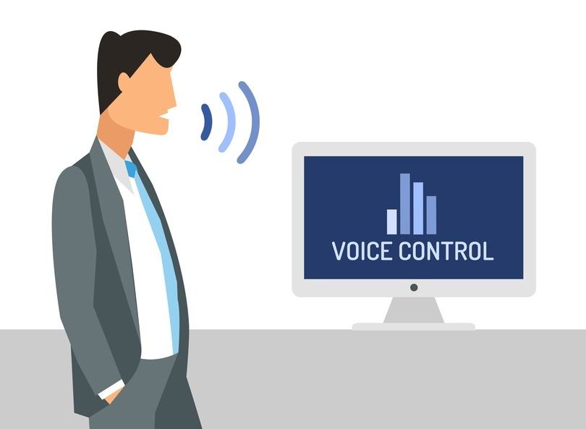
Key features / Benefits
Task can performed automatically using audio command
Provided face recognition protection for security
Can send voice email
Can perform various task like : opening cmd , notepad,
youtube, facebook

Slide 6

Softwares And Python Modules Used :
Python IDLE 3.7.0
Python Modules Used :
Face-Recognition (Including CMake & Dlib Modules)
Pyttsx3
SpeechRecognition
DateTime
OpenCV (CV2)
Requests
Wikipedia
Smtplib
Urllib3

Slide 7
Workings Of all Python Modules:
Face-Recognition
Takes User Image (First Image) & Second Image , Collect all facial data of both images , then they compare if Results come 0i.e false , for 1 i.e True
Pyttsx3
text-to-speech conversion library in Python
Speech_recognition
Taking audio input as speech
OpenCV2 library
For capturing image through camera

Slide 8
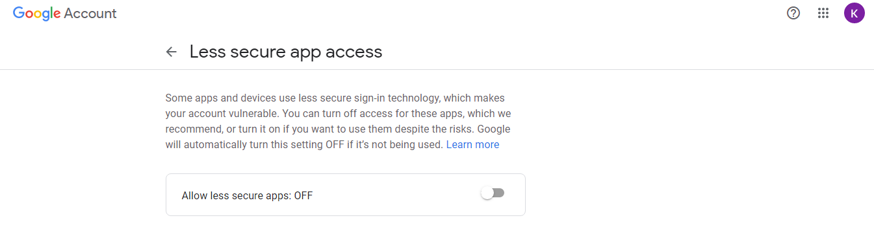
WebBrowser
For accessig and opening any website
Smtplib
For sending and accessing email through python
Note: You need to login with same id and pwd on gmail and you need to unable Less Secure App

Slide 9
Delevirables
Our code can be accessed through our Github Profile
Github Link : https://github.com/ketannikumbh/Face_Recognition_Voice_Command
2. Will be providing all files in one folder

